Slide 1
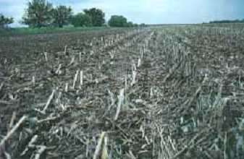
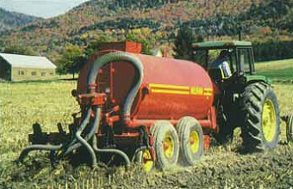
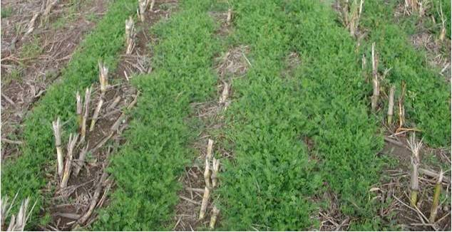
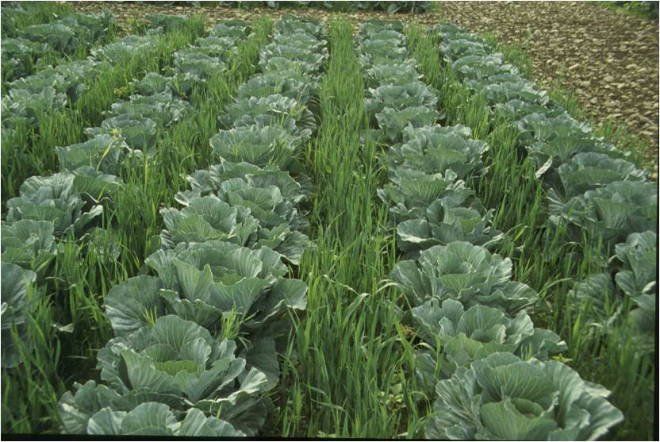
Conservation Agriculture & Soil Health: the US Perspective
Travis Idol
Natural Resources & Environmental Management
University of Hawaii-Manoa

Slide 2
Timeline of Important Events in Conservation Agriculture
1837
Steel plow; breaking of sod in Midwest grasslands
1930-36
Severe drought results in massive wind erosion, the “Dust Bowl”
1935
Soil Conservation Service (SCS) created by Congress
1970
No-tillage agriculture popularized
1972-3
Passage of Clean Water Act and Endangered Species Act
1978
Publication of Universal Soil Loss Equation (USLE) handbook
1985
Conservation Cost-Share Programs: Environmental Quality, Wildife Habitat Improvement, and Conservation Reserve Programs (EQIP, WHIP, CRP)
1992
USAID begins Sustainable Agriculture and Natural Resources Management Cooperative Research Support Program (SANREM CRSP)
1995-8
Approval and release of Round-Up Ready and Bt-engineered crops

Slide 3
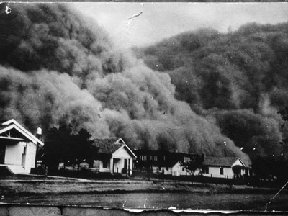
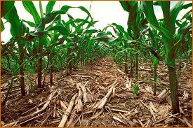
Protecting the Soil
Soil Conservation Service created in wake of dust storm reaching US capital
Focus on controlling water and wind erosion through residue management, crop rotation, and contour farming
Conservation tillage and no-till options promoted with development of modified plows, seed drills and variety of herbicides

Slide 4
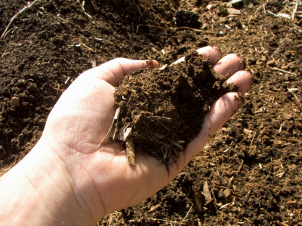
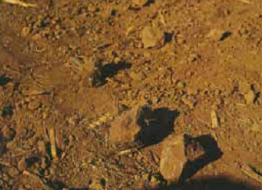
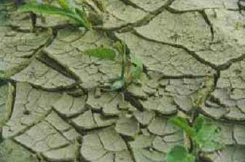
From Practices to Outcomes: Soil Quality Indicators
Soil organic matter: improves many soil properties; sign of healthy living system
Aggregate stability: resists erosion
Infiltration: reduce runoff, improve available water
Crusting: sign of poor infiltration and susceptibility to runoff
Porosity & size distribution: enhancing water infiltration, storage, and release to plants

Slide 5
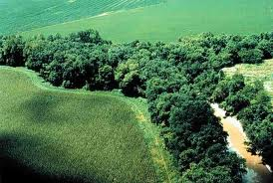
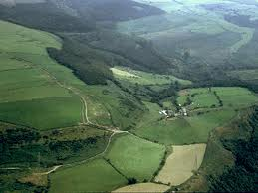
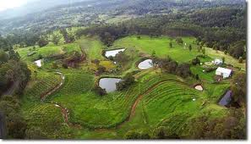
From Erosion Control to Natural Resource Quality
Surface and ground water quality Wildlife habitat Protection of special areas
Agriculture as part of a landscape
Healthy Sustainable Environment Agriculture

Slide 6
Major Tools for Conservation Agriculture
US Soil Survey
Land capability classification
Conservation practices manual
USLE and revisions
Watershed modeling and GIS
Ecological Site Inventory

Slide 7

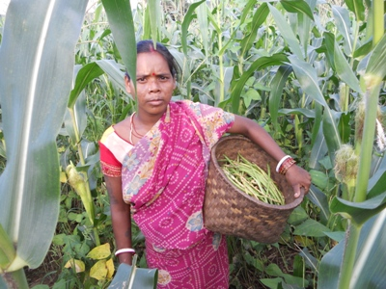
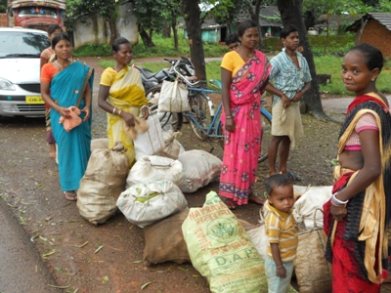
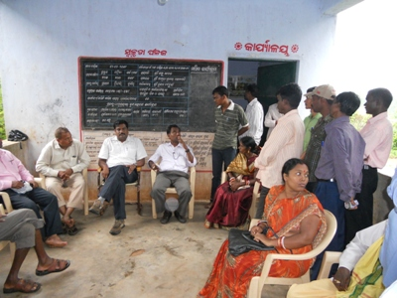
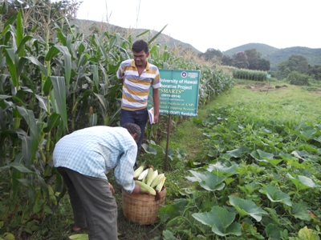
SANREM CRSP: Conservation Agriculture for Developing Countries
Promoting sustainable agriculture and farmer livelihoods
Uses participatory approach to enhance
Soil quality
Economic returns
Empowerment of women
Technology networks
Primary focus is food staples: rice, maize, sorghum, etc.

Slide 8
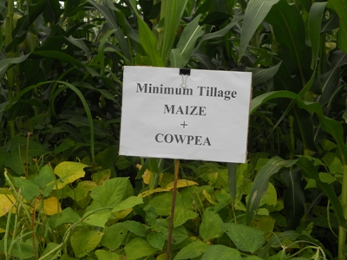
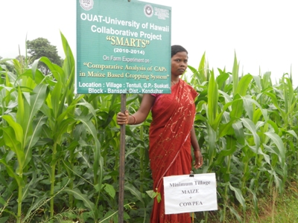
SANREM CRSP: Conservation Agriculture for Developing Countries
Promotes integrated conservation agriculture production systems (CAPS)
Minimum soil disturbance
Continuous soil cover
Crop rotation/intercropping
CAPS being applied to 7 regions of the globe in 20 countries
Maize-based systems predominate

Slide 9
Summary
Conservation agriculture in US primarily a response to degradation and loss of productive soils
Soil quality the foundation of sustainable agriculture and healthy environment
Standardized practices available for various regions, but indicators of soil quality provide assessment of impacts
Integration through CAPS viewed as best way to promote sustainable agriculture and farmer livelihoods throughout the world

Slide 10
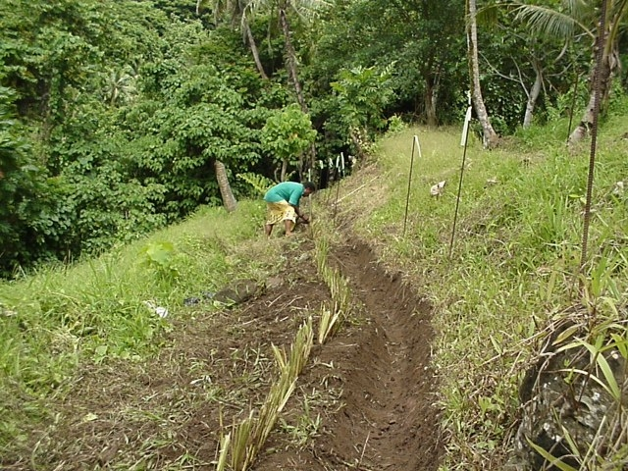
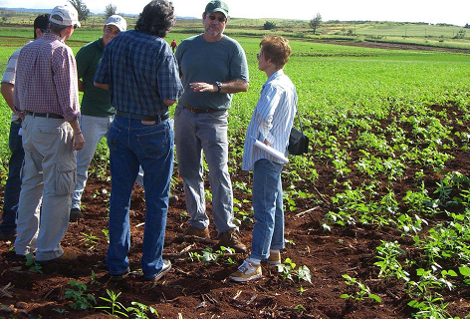
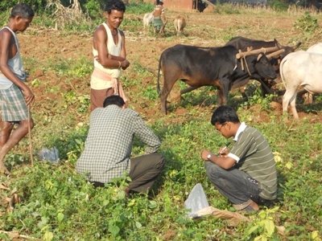
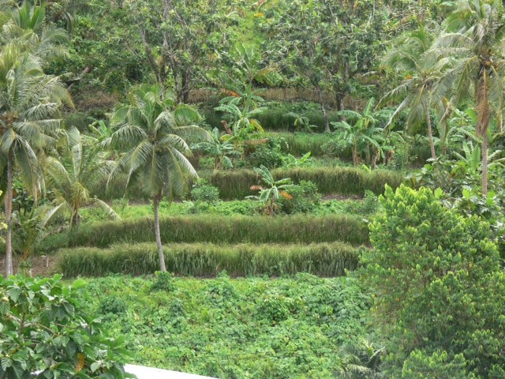
ଧନ୍ୟବାଦ୍ (Thank You)

